Slide 1
Individual Development Plan
Explorations in STEM/REU Programs 2020
Navid Vafaei-Najafabadi
Assistant Professor – Physics and Astronomy Department

Slide 2
Synthesis
Life is about managing resources, primarily time and money
An individual development plan is a plan to manage your time in order to achieve your goals
A SMART goal is one that is Specific, Measurable, Achievable, Realistic, & Time bound
Your career goal should lie at the intersection of your interests, your values, your skills, and what will create the greatest return on your investment (i.e. what does society really really need you to do?)
You must consciously and actively practice the critical skills you need for a career you want to pursue

Slide 3
Warning! This seminar includes a lot of philosophy!
Please speak up if I say something you don’t agree with!

Slide 4

Life is about managing resources
Time is your most precious and scares resource
“Managing” a resource means to apply it to progress along a path of your choosing
You must clarify in your mind,
Where your current path takes you
Is that goal the same as the one you would like to reach
How to influence your path from where you are
An individual development plan is a framework that allows you to organize your thoughts around this objective

Slide 5
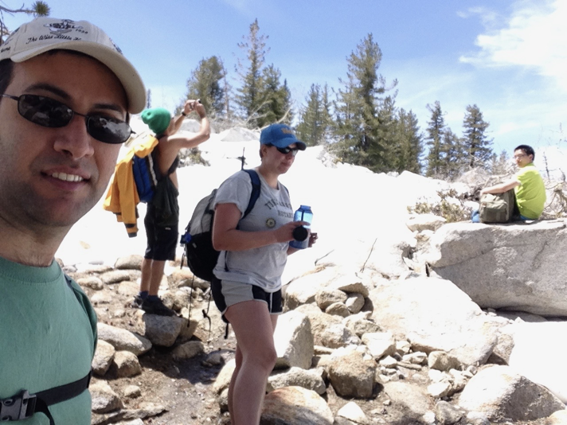
Reaching a summit
Cloud’s rest hike
5000 ft of elevation gain (and loss) in 16 hours
… is the culmination of a thousand unimportant steps
Notes:
A little story to help reflect on the important elements of reaching a goal

Slide 6
On Keeping Going
What would you need to wake up at 2 in the morning to be at the summit by 6?
Something better than sleep, seeing the sunrise (a Goal)
Aspiration to counterbalance the pain when it gets rough (your values & aspirations, e.g. joy of being out in nature & with friends)
A good map (a Plan)
Sufficient water, food (Preparation, this one is on you!)
No lollygagging around on random side paths (Keeping on doing what is “better” even though the side paths look enticing. Buddhists call this renunciation, psychologists call it delayed gratification)

Slide 7
An individual development plan is a framework that …
Lays out your skills, so you know what needs to be strengthened
Explore your interests, so you know what it is that you actually enjoy doing
Clarifies your values so you know what brings meaning to your life
Helps you choose a career goal that is worth pursuing
Creates a clear path from here to there

Slide 8
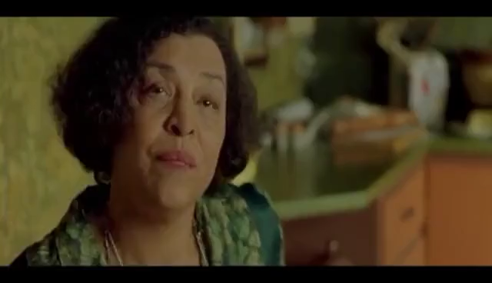
Let’s start at a very beginning…
“Know Thyself”

Slide 9
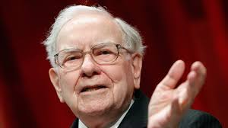
Values
What is important to you? e.g. Serving your community, putting a lot of care into the quality of your work
What is the essence of the actions that bring you joy? Where are you in your element
Sometimes you can answer this more easily by reflecting what it is that makes your stomach to churn!
“If I can make a $100 million dollars on a deal with a guy who causes my stomach to churn, I’ll say no…because I say it’s like marrying for money, which probably isn’t a good idea under any circumstances, but it you’re already rich, it’s crazy, right?!”
It’s ok if your answers to these questions are “I have no idea”! We’ll go through a practice later in the seminar

Slide 10
Interests
What is it that you enjoy doing?
In your first pass at this go ahead and write everything down: hanging out with pets, video games, math, explaining things, programming,…
In your second pass at this, encircle things that someone might want to pay you money to do: These are how you create value in other people’s lives, and in the society at large
Let’s take a minute and write some of these down…

Slide 11
Skills
What are you good at?
What do people (family, friends, teachers) turn to you for?
This is similar to the previous exercise:
In your first pass at this go ahead and write everything down: taking care of pets, video games, math, explaining things, programming,…
In your second pass at this, encircle things that someone might want to pay you money to do: These are how you create value in other people’s lives, and in the society at large
Let’s take a minute and write some of these down…
Notes:
Example of the math corp in my class

Slide 12
Matching to a career fit
Once you have a sense of what it is that you can do and you are looking for, you can seek what career fits you. There are a couple places to look:
Sometimes it is obvious! Hint: ask your friends!
Look through database of jobs, e.g. Link (Hint: sort them by income)
I would choose maybe 5 you think are a good fit for you
Then (and this is the most important part) confirm the hypothesis of it being a good fit for you by doing an informational interview with someone who actually has the career you want
Notes:
good at explaining and like working with children

Slide 13

Informational Interviews
An informal interview with someone in a career you may want
Who to choose?
Someone with a similar background to you
Someone with whom you share a link (Hint: search for your college’s graduates on LinkedIn)
What to ask them?
Craft questions that verify that the goal is in the cross section of your skills, values, and interest
The Rule always is senior people help junior people, so don’t be afraid to ask about things they hate about their jobs!
Notes:
Let them see a younger version of themselves in you
Don’t be afraid to reach out to people you don’t know and don’t be afraid to follow up.

Slide 14
More on skills
Determine the list of the “critical skills” for the career you are interested in
This is a great subject to bring up in the follow up e-mail to your informational interview

Slide 15
Critical Skills in Professional Research
Writing
Presenting
Learning
Data Analysis
Organization
Of these, you only get trained for one (two if you are lucky) in school

Slide 16
Making goals to improve your skills
Once you determine the critical skills you need, you need to set a goal for yourself to obtain them. There are three general sets of goals:
Career advancement goals to help you move forward in your career, e.g. completing this IDP, identifying mentors for informational interview, understanding the landscape of professional opportunities, etc
Skills development goals to improve upon skill and knowledge areas in which you may be deficient
Project completion goals Break your skills-development goals into project that will allow you to become proficient at them, e.g. writing a paper, writing a grant/fellowship proposal, presenting at a conference, etc

Slide 17
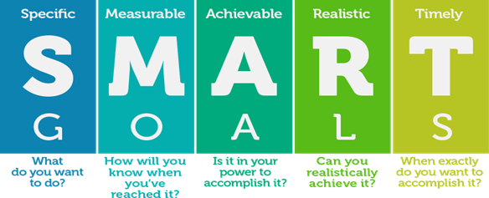
Smart goals

Slide 18

A specific goal has a clear “scope”
It needs to have clear enough boundary conditions, so that you know when you are done
Examples:
Non-specific: I want to learn more math
Specific: I want to review the book chapter on Fourier series
Non-specific: I need more mentorship
Specific: I need to identify and contact two people as mentors
Notes:
This is one of the concepts that a lot of people have trouble with

Slide 19

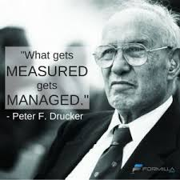
Create goals, where your progress can be tracked, preferably quantitatively,
E.g. “Read through the first 4 chapters of the book by the end of the month” instead of “Read this book”

Slide 20


Your goal must be within your control:
Achievable: I will ask this person to marry me
Not achievable (at least legally!): I will make this person marry me

Slide 21

Double edged sword:
Failing to achieve even a non-realistic goal is demoralizing
Without trying, you won’t know the boundaries of your strength
My advice to you is to be aware of what you can do now, and in setting goals try to reach a little further than you think you can, just to challenge yourself.
Incidentally, this is how I write my exams!

Slide 22

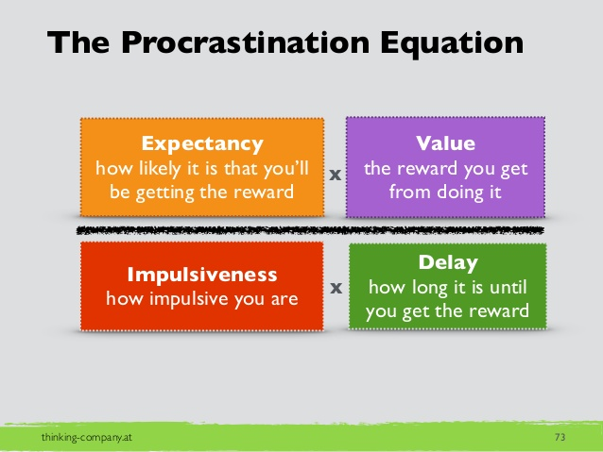
An action with an infinite timeline will never get done
Give yourself “internal” deadlines for tasks that don’t have a tight deadline or an external deadline.
Lack of deadlines is subtle and insidious. It is one of the four components of procrastination. (see procrastination equation)
You should already have a timeline for your project. If you don’t, ask your advisor to help you make one.

Slide 23
Mentorship
When to ask for mentorship?
Mentorship is very important at the decision “cross roads” or when you are confused about the “next steps”
It allows you to visualize possibilities you haven’t considered from the point of view of someone who might have had your experience
Be skilled enough to recognize critical cross roads and humble enough to recognize confusion
Who to ask for mentorship
Someone with a similar background to you
Someone who has (extensive) experience in navigating the same problems as you are (e.g. your seniors in the field, your advisor)
Notes:
Cut through what is critical

Slide 24
Tips on Mentorship
Approach your mentor having done some initial research about the potential paths you can take
Ask questions not answers
The best way to learn is to teach others, so mentor your junior colleagues
Mentorship doesn’t have to be formal. In the course of your career you will meet great people, whom you admire. Keep in touch with them and call them in the time of your need.
You are the origin and heir to your actions. Only you are responsible for what you do

Slide 25
Bonus Material: A Little on Time Management
The number of things you can do during a week is surprisingly limited.
There are different frameworks for time management like David Allen’s GTD method, Eisenhower’s matrix, writing today’s task on posted notes, etc.
I have tried most of them at least for a while, and will tell you how I managed my time, but first, some principles:

Slide 26
Principles of Time Management*
Define your own priorities
Don’t let your time be dictated by other people’s priorities
Set time boundaries
Step 1: Decide how long you intend to work and reserve time for yourself and your family
Step 2: Stick to it!
Delegating: The more your time becomes restricted the more important it becomes to find reliable people to delegate work to
Don’t use your mind for keeping track of tasks
Rein in your email
Use the first hour of your work day effectively – This one is in many ways like brushing your teeth!
* From the “PI crash course”, Columbia University
Notes:
Concept of leverage… This will not apply to you for a while, but know that delegating is a thing

Slide 27
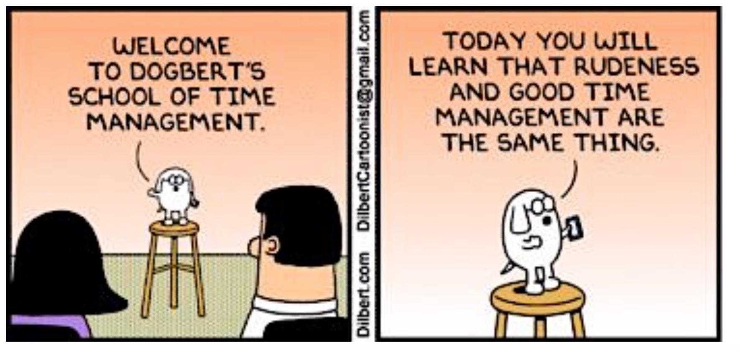
Define your own priorities
Say no!

Slide 28
Define your own priorities
If you have already defined your goals and set your deadlines, your day to day priorities will naturally flow from those
You should know your priorities for some time into the future, e.g. set weekly priorities
Divide your time into productive blocks of time. For me, a block is 1.5 hours
My typical day only has 3 of these…That’s it!
For complicated tasks with large “overhead”, I usually need two blocks for the same tasks in one day.
Once you have allocated your time, you can legitimately turn other people down because there is literally no more space in your timeline for doing things!
Notes:
This is how you allow time for your own priorities rather than other people’s

Slide 29
At all costs avoid interruptions. E.g. I have two hours a day when students can walk into my office. Otherwise there is a board on my door that says “working, please do not disturb”
Notes:
This has to do with the concept of the state of flow

Slide 30

Get tasks out of your head
I have a terrible memory and so do you!
Gather all your tasks in one location for “processing”
Processing:
When will it be done
All the important tasks must have dates
Where is its home?
Is it part of a project?
Is it part of a collection of tasks that makes sense to be done together? E.g. email
Notes:
This is a fundamental principle of the GTD method

Slide 31
Use the first hour of your day effectively
Clean your email inbox every morning
Create tasks with links to the emails rather than marking them “unread”
Review your task list, mark those due today with a “Today” tags and those to be done tomorrow with a “Tomorrow” tag
Plan your day in half hour increments, starting from your appointments
If you do this everyday, it will take around 30 min to an hour.

Slide 32
My workflow – Collecting and Processing Tasks
I recommend a simple note taking app with highlighting and checkbox ability. I really like “Bear”. It also lets me add links to other notes and documents.
I have the following categories in a single file:
Major Projects/Commitments (usually for a semester)
Urgent/unprocessed
Follow up
Inbox/Orphans
Named Projects, e.g. Workshop report
Done

Slide 33
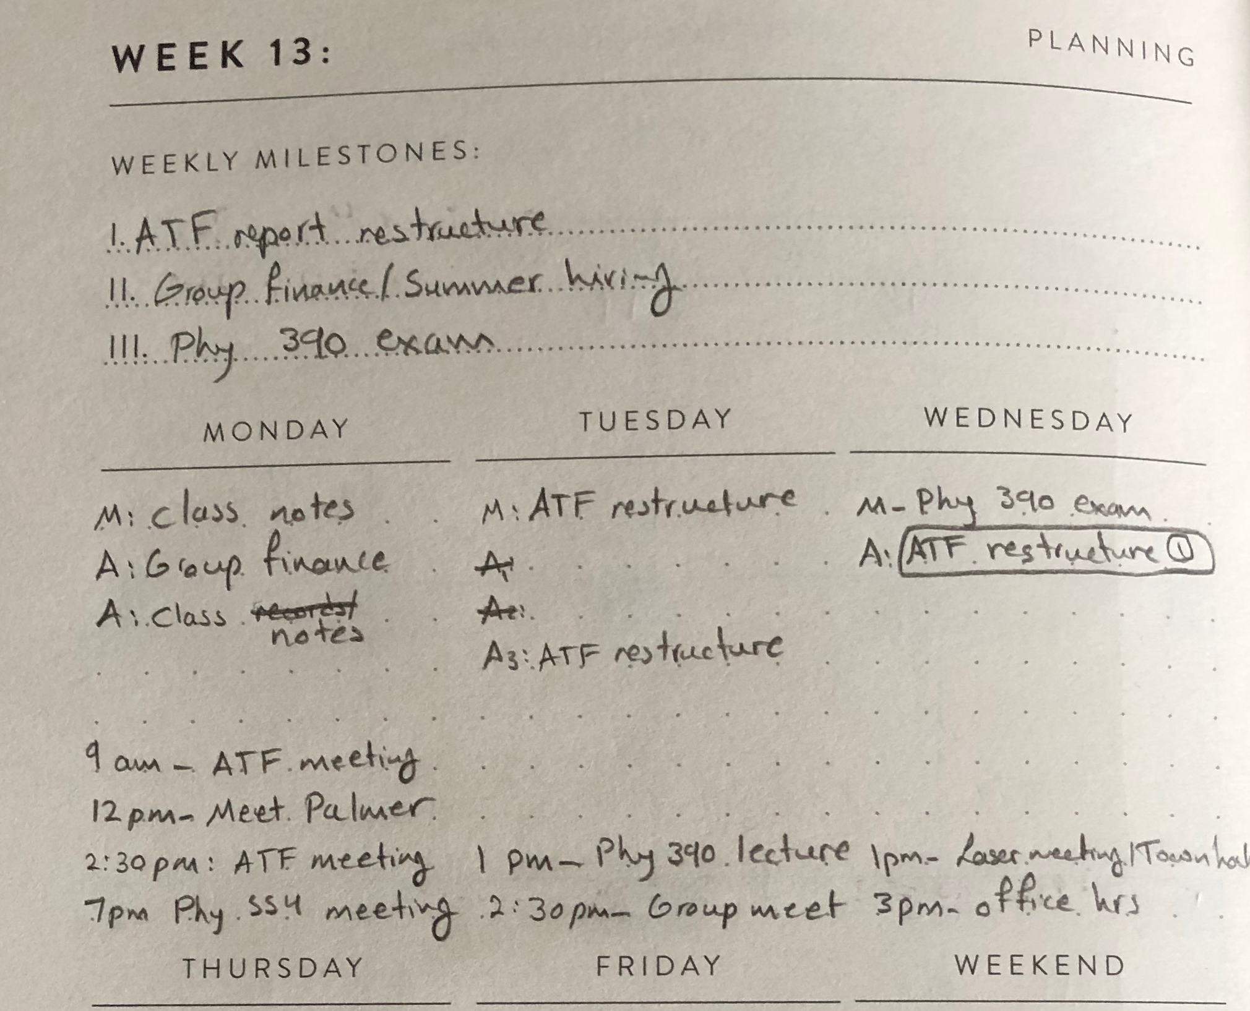
My workflow – Defining the week’s blocks
I have a written planner made by “Best Self”

Slide 34
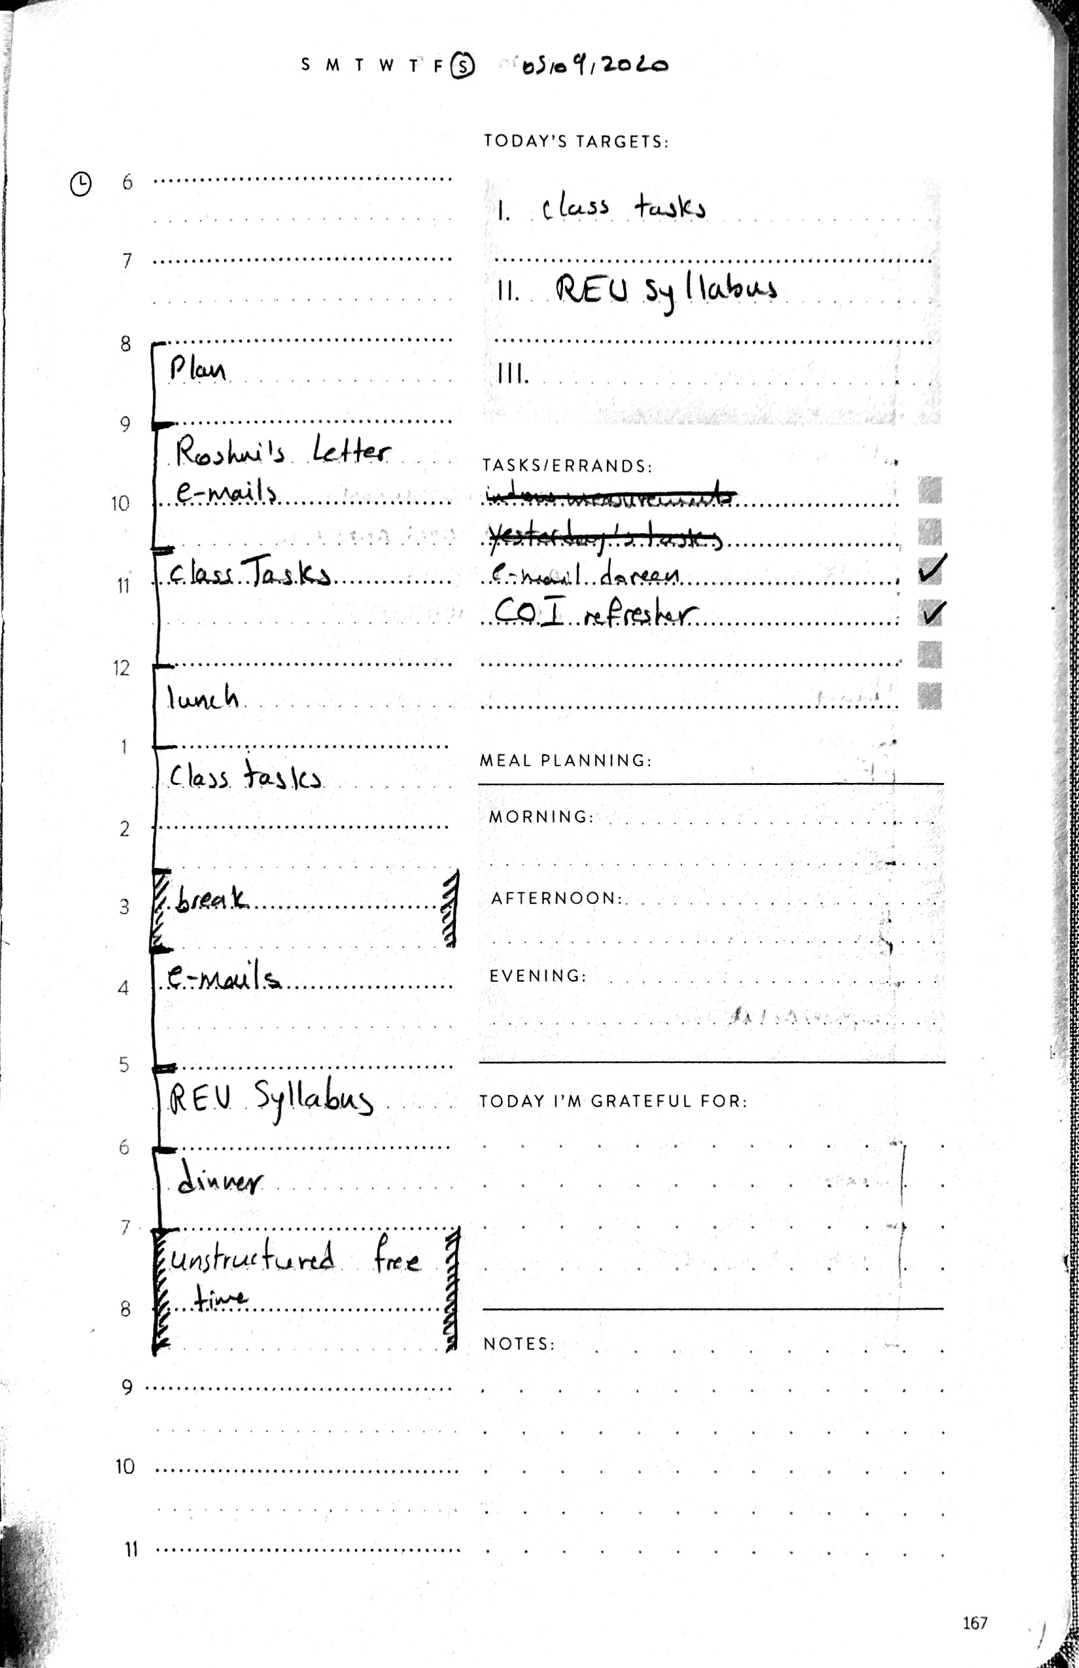
My Workflow – A day in the life…

Slide 35
Exercise: Make your own IDP
Make a word document
Compile a list of your values*
Compile a list of your interests
Compile a list of your skills
Compile a list of candidates of careers of interest
Compile a list of potential people for informational interviews
Extra Credit:
Identify critical skills you have yet to develop
Create SMART plans for developing them
* Keep these lists career related and limited to ~5 items

Slide 36
Resources
•Stony Brook University: Integration of Research, Education and Professional Development (IREP)
•https://grad.stonybrook.edu/professional-development/idp-toolkit/
•Science Magazine •myIDP: http://myidp.sciencecareers.org •A series of articles designed to help Post-Docs create an Individual
Development Plan (IDP) using myIDP
▪ http://doi.org/10.1126/science.caredit.a1200100 ▪ http://doi.org/10.1126/science.caredit.a1200107 ▪ http://doi.org/10.1126/science.caredit.a1200123 ▪ http://doi.org/10.1126/science.caredit.a1200135 ▪ http://doi.org/10.1126/science.caredit.a1300047 ▪ http://doi.org/10.1126/science.caredit.a1300125 ▪ http://doi.org/10.1126/science.caredit.a1300146 ▪ http://doi.org/10.1126/science.caredit.a1300173 ▪ http://doi.org/10.1126/science.caredit.a1300206 ▪ http://doi.org/10.1126/science.caredit.a1300263 ▪ http://doi.org/10.1126/science.caredit.a1400027 ▪ http://doi.org/10.1126/science.caredit.a1400094

